Slide 1


IMDB Movie Analysis
By – Pratham Mehta

Slide 2
Project Description
In this project, we'll take on the role of a Data Analyst. As a data analyst, we’ll be given a dataset containing movie records. The job is to analyze this data and answer certain questions that can help the company make better decisions.
Our goal is to use your EXCEL skills to analyze the data of the Movies and understand why and which films are running successfully. We need to gather insights and help stakeholders to make informed decisions on the next movie.

Slide 3
Approach
The approach will be using the powerful EXCEL tools like Functions, tables and charts to gain insights from the given dataset.
With the help of the graphs and charts we will make the analyzes more pictorial and easier to understand to gather insights.

Slide 4
Tech Stack Used
The Software for spreadsheet application used is EXCEL.
Microsoft EXCEL is one of the most famous spreadsheet software and its powerful tools which are going to be used to gain insights from the dataset.
The three main tools used are Formulas, Functions and Charts

Slide 5

Insights

Slide 6
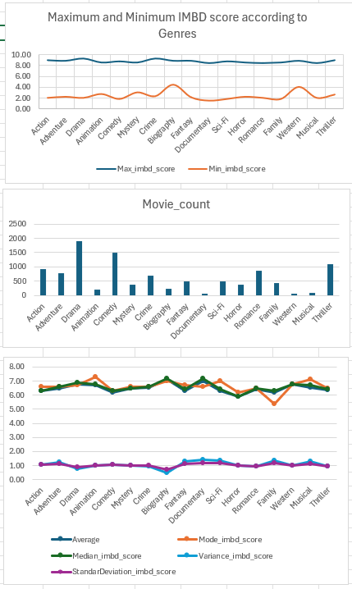
Movie Genre Analysis
Well, most of the movies had multiple genre in it making it more customer likeable. Most movies with Action, Drama, Crime, and Thriller have the highest IMDB ratings of all time.
Genres like Biography and Western don’t have very low lowest but have good highest and average ratings, where Biography has highest average and median ratings and lowest standard deviation too.

Slide 7
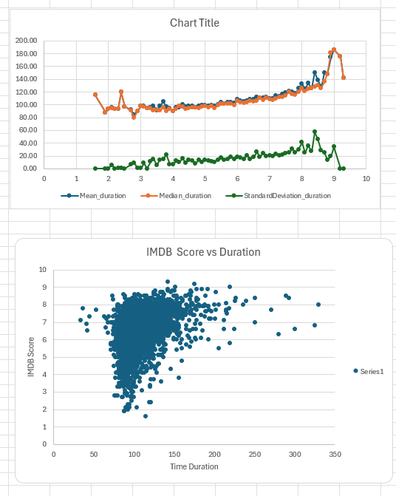
Movie Duration Analysis
Movies with 140-200 duration have generally a IMDB score of 9+ with and movies have 8+ ratings for mean duration of 133 minutes.
Movies with less than 110 minutes of duration have low IMDB ratings and have rating less than 7. Movies with these durations don’t have higher ratings and 7.

Slide 8
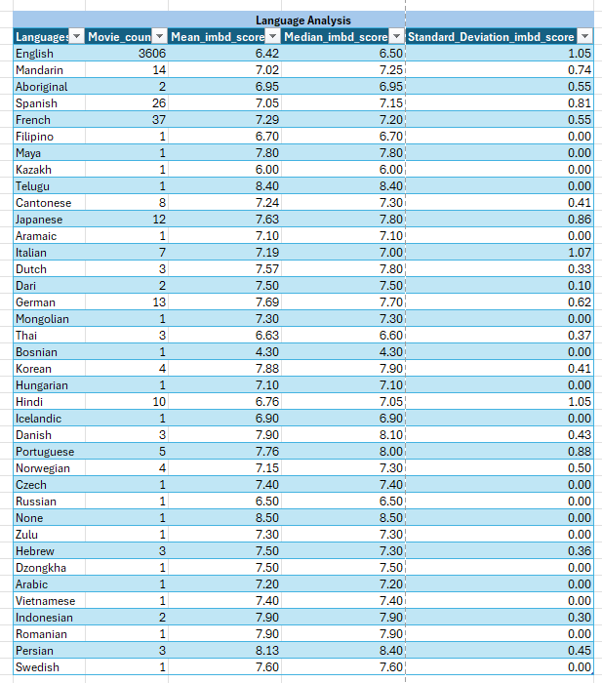
Language Analysis
Most of the movies are of English language. Where they have a mean of 6.42 IMDB score which is lowest out of all languages but has a big standard deviation of 1.05 and taking into the account of these many movies, it is a good score.
While 2nd most used language in films is French, and it has a mean of 7.29 as very few languages with these many films have such good scores. Spanish also has similar ratings and movie counts like French.

Slide 9
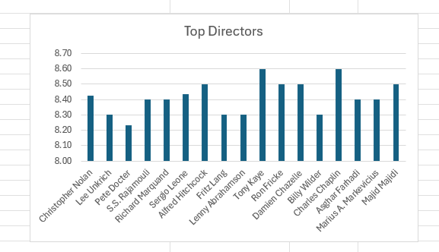
Director Analysis
Director with movies having the highest mean of IMDB scores are Toney Kaye and Charles Chaplin.
Out of the top directors the cutoff to be a top direct was 99percentile or 8.23+ IMDB score
The top few directors from the best directors are Tony Kaye, Charles Chaplin, Alfred Hitchcock, Ron Frickle, Damien Chazelle and Majid Majidi. All these directors mentioned have average score of 8.50+.

Slide 10
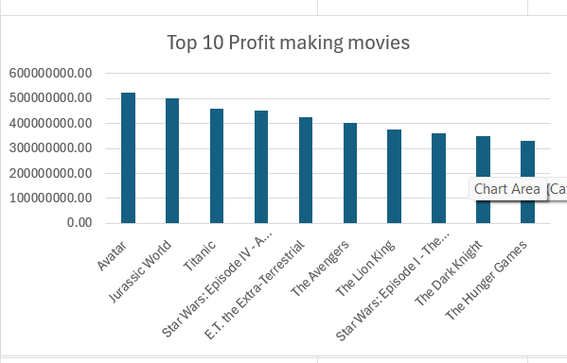
Budget Analysis
Out of all the films Avatar by James Cameron has the highest profit margin movie with a profit of 523million and Jurrasic World being the only other movie with 500million plus profit margin.
In the 400 million club we have movies like Titanic, Star Wars:EpisodeIV, Extra-Terrestrial and The Avengers
Movies with more profit more 330million are in the Top 10.

Slide 11
Thank You
https://drive.google.com/file/d/1obw3yGXckfQstfJntUQuwwGnNT9PD1wu/view?usp=drive_link

